Slide 1
Proposed
Capital project
safety…security…pride
December 12, 2018

Slide 2
The connection between the environment in which our children learn and the impact on their performance is well-known. It is imperative, then, that we “build their future.”
When we invest in our school facilities, we invest in the future of our children. They deserve a safe and secure learning environment that they can be proud of!
There is really no time better than now to take on the challenging task of aligning the quality of our physical facilities with the expectations and desires we have for our students’ school experience and their overall achievement.
The future truly is NOW!

Slide 4
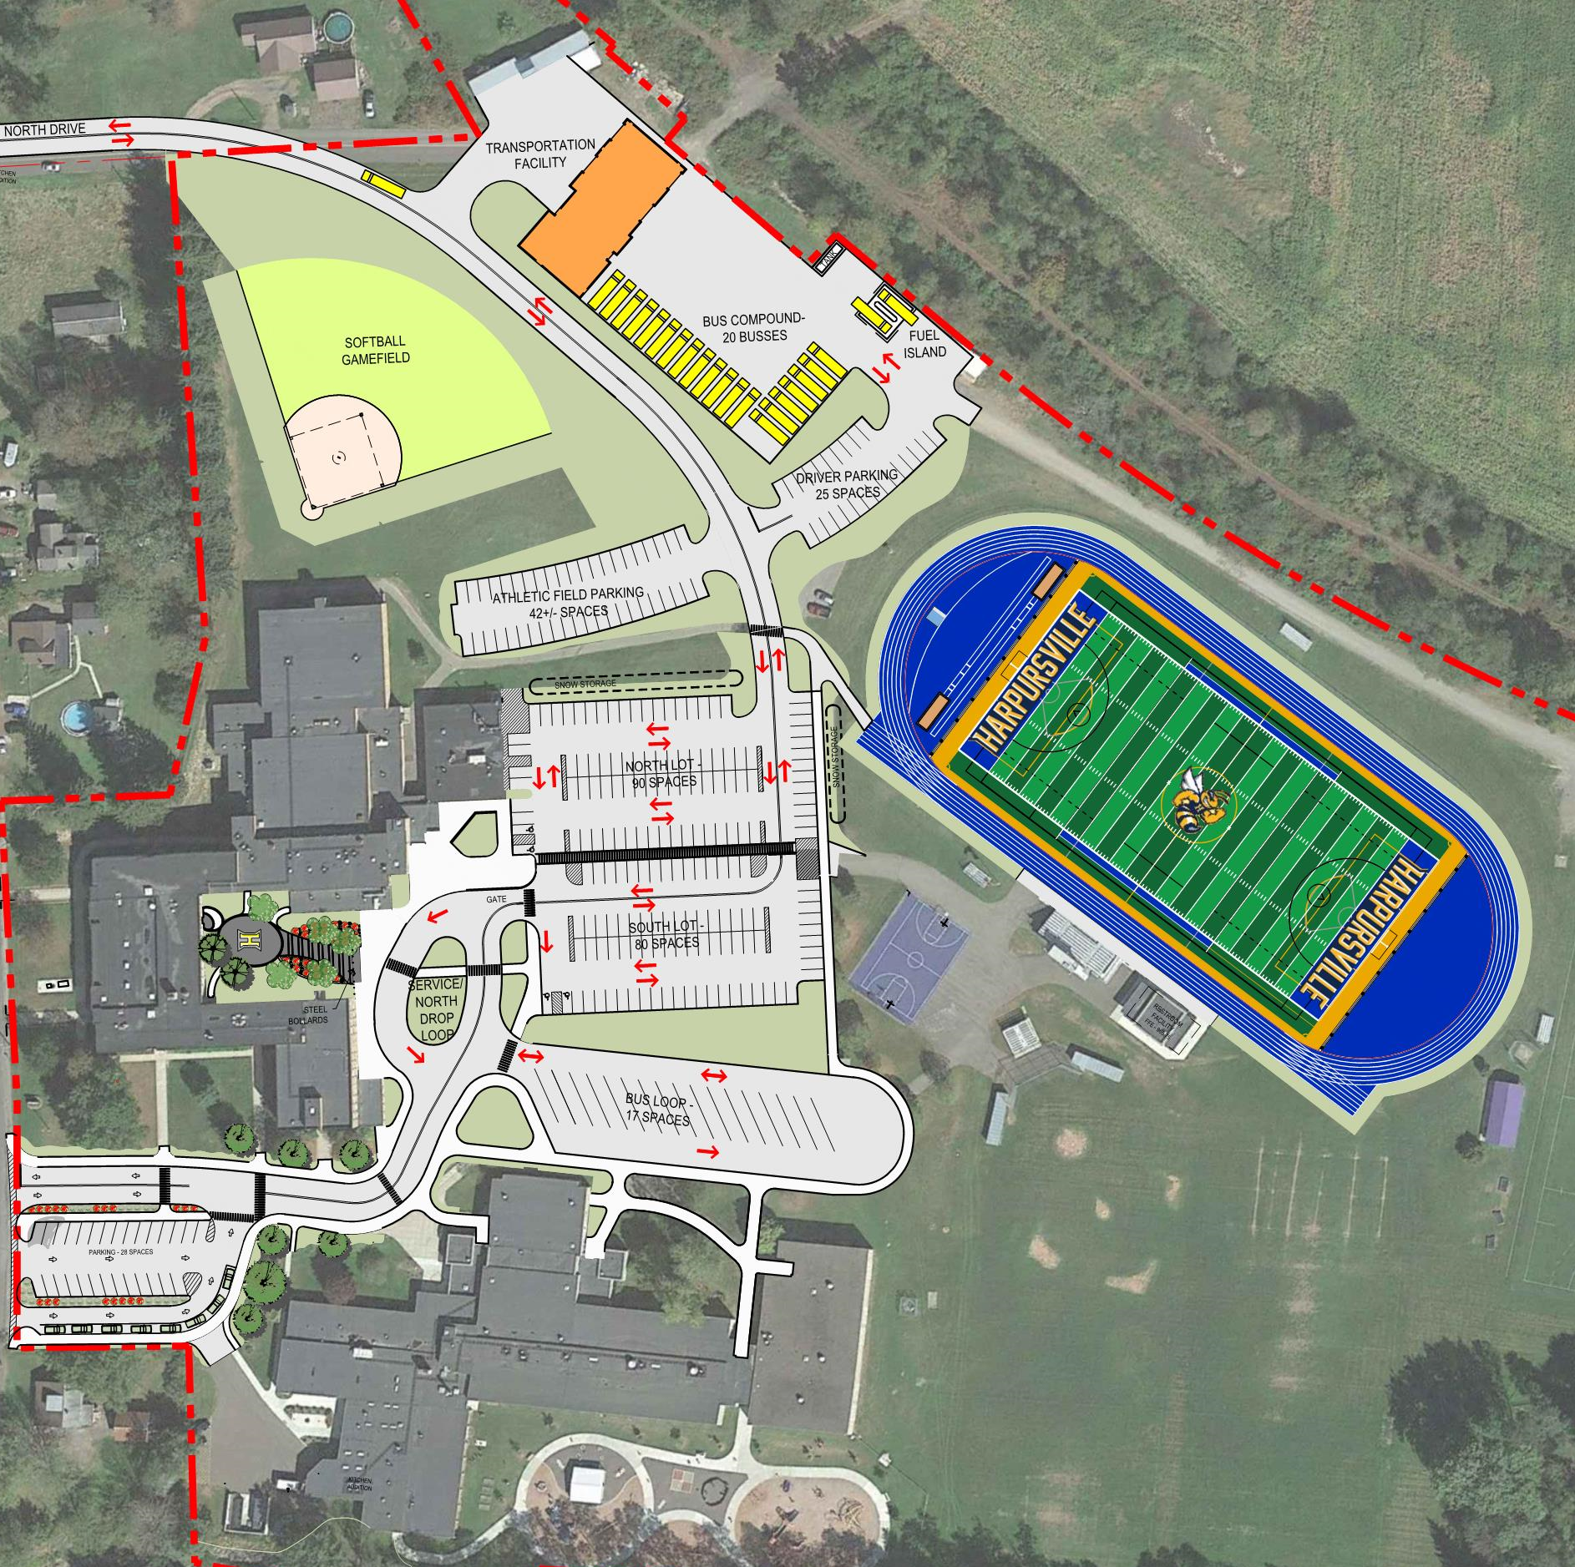
The master site plan
Completed over 2 phases:
Phase 1 (2019)
Phase 2 (3-5 years out)
*Phase 2 items will require a separate public vote in the future.

Slide 5
“So you’re telling me there’s a plan?”
Phase 1 (2019 project) – allows us to take care of those “have-to” items that are beyond their useful life.
Infrastructure – safety, security, maintenance items that ensures the critical components in our buildings are updated.
Improve the safety and security of our schools while increasing our “hornets pride” – school/community pride becomes readily apparent across our campus.
Major systems in both buildings will be updated – this clears the way for the district to take care of those phase 2 items.
We move out of a maintenance mode to an “enhancement/growth” mode!
Phase 2 (future project, 3-5 years down the road – requires another public vote and approval – completely separate project/process) – allows us to address those items that SIGNIFICANTLY enhance our campus.
Parking lot safety, pedestrian safety
Providing top-notch facilities for our students (multi-purpose turf athletic field, new track, new softball field
Enhanced parking areas, safe traffic flow, sidewalks, lighting
New transportation facility – on campus
Dedicated bus loading area, drop-off/pick-up loops for both buildings.
Overall, a much more inviting, attractive, safe campus plan.
February 2019 vote is only related to phase 1 items!

Slide 6
What are the “Phase 1” items that are a part of the February 12, 2019 project vote?

Slide 7
Scope of work…W.A.O. Elementary
(HIGHLIGHTS)
Improve parent drop-off/pick-up
Walk-ways for students much safer
Closer to school for drop-off/pick-up
Traffic flow improved
Make entrance to campus more inviting
Roof replacement in the 5th/6th grade wing (entire building roof will be “new” after this)
Improve ventilation & airflow for students
Improved air and thermal comfort has a positive impact on concentration, health, behavior, and achievement
Security upgrades
New electrical feed relocated to a safer place

Slide 8
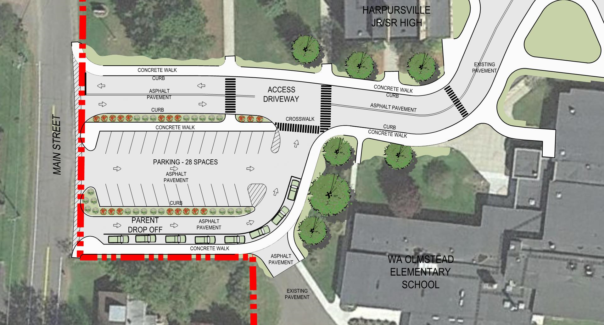

Slide 9
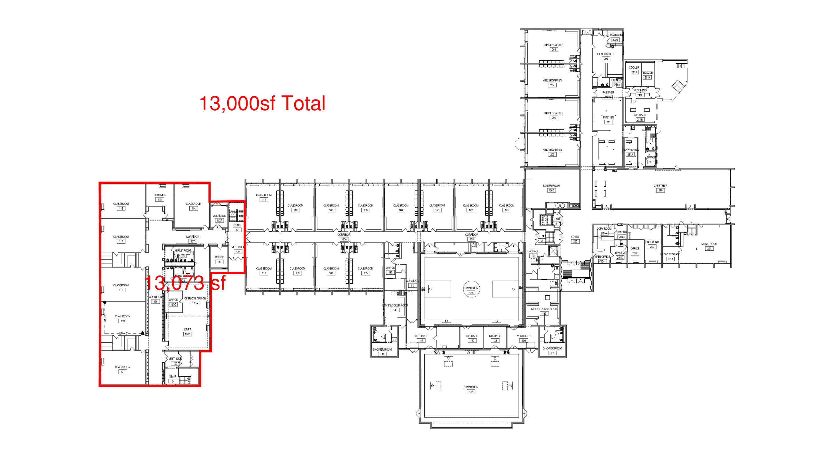
W.A.O. Elementary Roof

Slide 10
Scope of work…W.A.O. Elementary
(Detailed look)
SITE Work
Parking lot, entry drive improvements – improve parent drop-off/pick-up
ARCHITECTURAL
Roof replacement in the 5th/6th grade wing (entire building roof will be “new” after this)
MECHANICAL(HVAC)
Replace exhaust fans, ventilation systems, and unit ventilators (many are at end of useful life; airflow improvements)
ELECTRICAL
Technology and security upgrades (tech infrastructure upgrades; intrusion, door contacts, additional cameras)
Pad mounted transformer and new electrical feed (a must with site work above)
Work is estimated at about $2.7 million. The elementary building had significant work done in the last capital project.

Slide 11
Scope of work …Jr. Sr. High
(HIGHLIGHTS)
Main entrance & courtyard enhancements (tied to septic tank)
Improve building security features
Blue gym gets a complete makeover; gold gym gets natural light
Auditorium gets a complete makeover – including A/C!
Improve ventilation & airflow for students
Improved air and thermal comfort has a positive impact on concentration, health, behavior, and achievement
Lighting upgrades in all areas of the building
The quality of light received by students impacts their achievement and health.
Significant roof replacement
Replace site septic tank (very important)

Slide 12
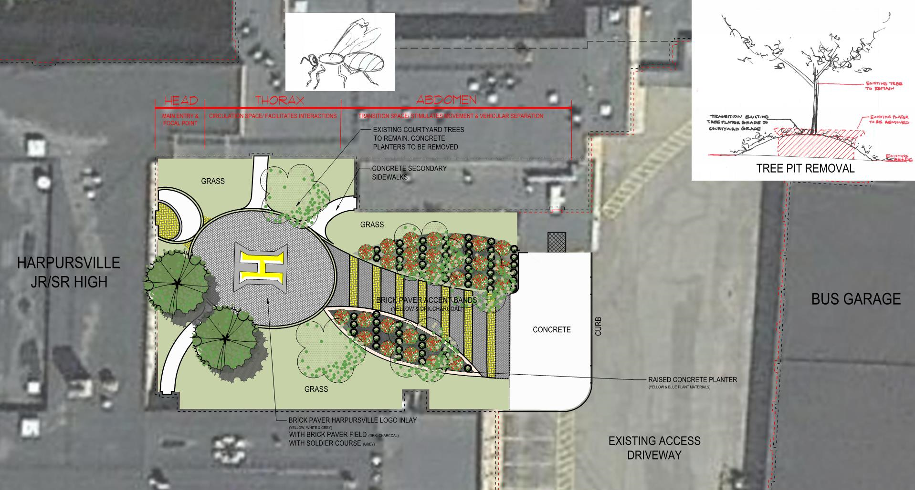
Jr. Sr. High
Courtyard & Entrance
Enhancing the entrance to the building & improving our facilities branding (i.e. growing our “hornet pride”).

Slide 13
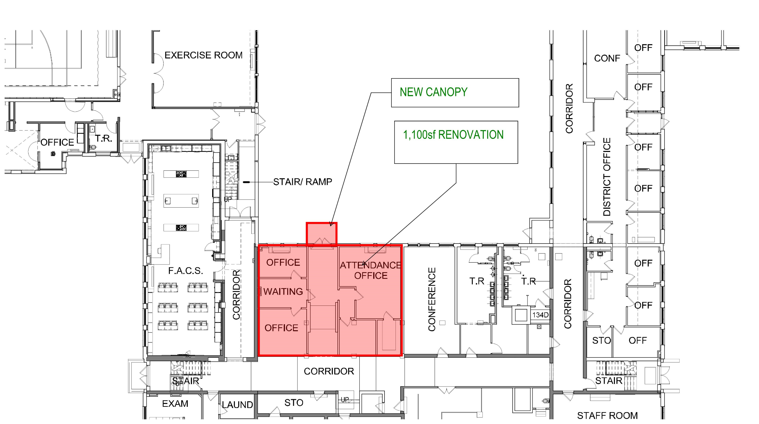
Jr. Sr. High Main Entrance

Slide 14
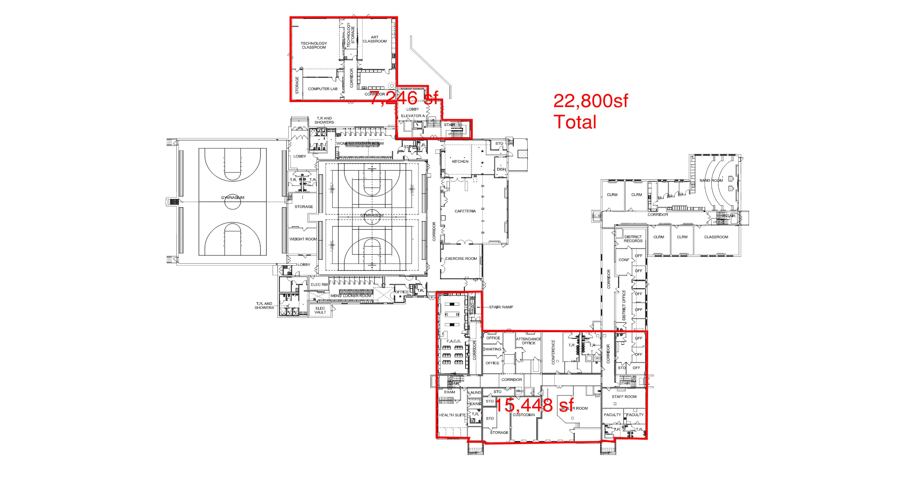
Jr. Sr. high Roof

Slide 15
Scope of work …Jr. Sr. High
(Detailed look)
SITE Work
Site septic tank (very important)
Main entrance & courtyard upgrades/renovation; other entrance improvements: stair railings in need of repair, storm drain repair
ARCHITECTURAL
Main entrance enhancements (security features, reconfiguration to enhance space and functionality)
Exterior door replacement – selected doors
Significant roof replacement on multiple roof elevations (tech/art wing, original 1935 building, 1944 addition)
Old gym needs natural light (code requirement, windows added to side walls)
Blue gym gets a complete makeover (bleachers, padding, basketball hoops, floor re-done with new striping and custom logo in the middle, paint)
Auditorium – significant upgrades (new chairs, stage refinished, all lighting, sound system, paint)
PLUMBING
Replace galvanized piping, update bathrooms, mop basins, water coolers/drinking fountains upgrades and additions, mop basins
MECHANICAL(HVAC) – significant work desperately needed
Replace exhaust fans, ventilation systems, and unit ventilators (many are at end of useful life; airflow improvements)
Various building heating systems need upgrading
Auditorium air conditioning added; air conditioning in computer rooms, data and electrical closets added or replaced
ELECTRICAL
Technology and security upgrades (tech infrastructure upgrades; intrusion, door contacts, additional cameras)
Pad mounted transformer and new electrical feed (required with auditorium A/C)
Lighting upgrades (hallways, classroom, custodial closets, auditorium)
Work is estimated at about $7.8 million. The Jr. Sr. High School building is in critical need of significant infrastructure work.

Slide 16
If the February 2019 vote is successful (i.e. “phase 1”), the site work, as shown, will seamlessly integrate into any future projects involving site work that the district might choose to do.
It could look like the “phase 2” design, but the details on that will be worked out in future years. There’s always more planning to do and the needs of the district may change, leading us to a different design. But, at least there’s a concept and a plan.
The next 2 slides show both of these things…
- Notice the work that is planned as part of February 2019 project and what the campus will look like after that work is completed.
- Notice what the campus could look like if the district chooses to do some or all of the site work items shown as a concept for down the road (i.e. a “phase 2” project). The February 2019 vote doesn’t involve any of these items.

Slide 17
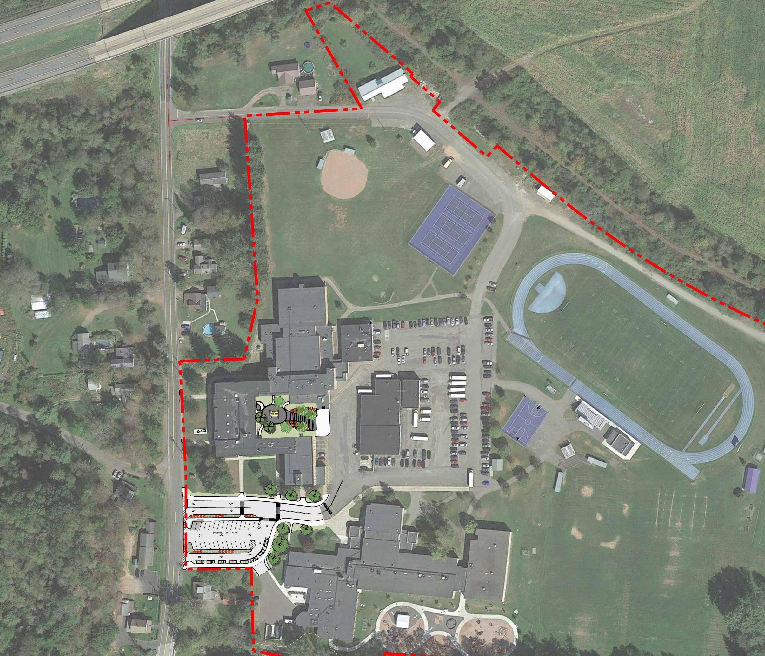

Slide 19
Funding for the project
TOTAL PROJECT COST | $10,651,665
Capital Reserve | $504,550
Fund Balance | $500,000
Local Share | $9,647,115
Building Aid Ratio is about…93%
Smart School Money (applied after $ received) | $1,173,008
Average Levy Impact (per year for 15 years) | $49,030 (1.21%)
Average impact of 1.21% | $0.185 per $1,000
 | $18.50 on a $100,000 home
 | $1.54 per month

Slide 20
Timeline and plan moving forward
PROPOSED PROJECT TIMELINE
Phase | Start Date | End Date | Duration
Progress Meeting | Oct. 23, 2018 | Oct. 23, 2018 | - - -
Board of Ed. Presentation | Nov. 14, 2018 | Nov. 14, 2018 | - - -
Board of Ed. Action/SEQRA/Set Vote Date | Dec. 12, 2018 | Dec. 12, 2018 | - - -
Referendum/Vote | Feb. 12, 2019 | Feb. 12, 2019 | - - -
Design | Feb. 2019 | Oct. 2019 | 8 ½ months
3rd Party Expedited Review | Oct. 2019 | Dec. 2019 | 10 weeks
Bidding | Jan. 2020 | Feb. 2020 | 4 Weeks
Award/Start Up | March 2020 | April 2020 | 4 Weeks
Construction | May 2020 | Sept. 2021 | 17 months
Close Out | Oct. 2021 | Dec. 2021 | 3 months
Currently allocated 10 months for SED review. Expedited Review process is also an option to reduce review time (approx. 10 weeks)
Engage stakeholder groups:
Board of Education
Student group
Faculty & staff group
Community group
Design phase includes continued feedback to ensure final elements reflect needs of district, stakeholder input, code, etc. while being contained within cost structure.

Slide 21
THANK YOU!
Go Hornets!

